Slide 1
Does Reddit Know Movies?
Predicting Box Office Performance Using Social Media Metrics

Slide 2
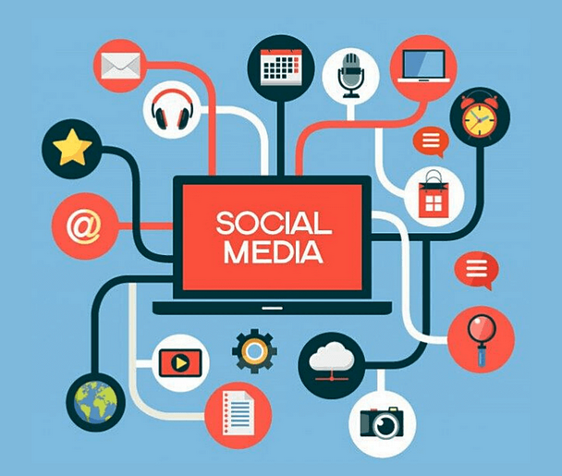
Topic Introduction
Word of mouth has a large impact on consumers’ choices
Proliferation of social media websites →
Centralized the location for discussion
Revealed previously unseen data
Word of mouth provides “significant explanatory power” for box office performance, especially in the early weeks after opening^{[1]}
Notes:
Img credits: https://empireflippers.com/social-media-dtc-ecommerce/

Slide 3
Problem
Solution
Movie studios attempt to drive online word-of-mouth through trailers and teasers
Online reactions to promotional content could be highly predictive of future earnings
Movie studios should desire to use these data to predict earnings and alter promotional strategies
Analyze pre-release comments on movie trailers to determine:
Sentiment
Engagement
Other word-of-mouth metrics
Predict opening weekend performance using our engineered features

Slide 4
Project Outline
1
2
3
4
Data Scraping
Merging & EDA
Modeling
Evaluation

Slide 5
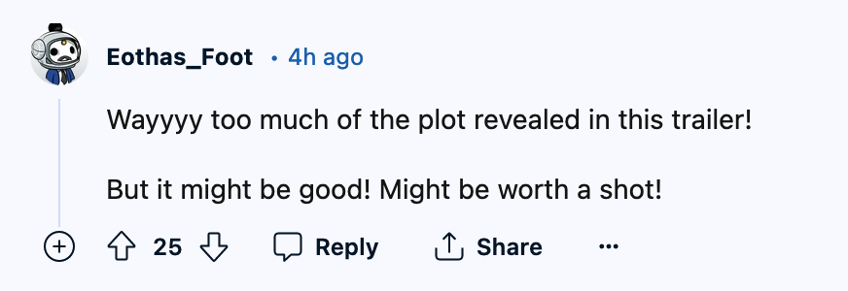

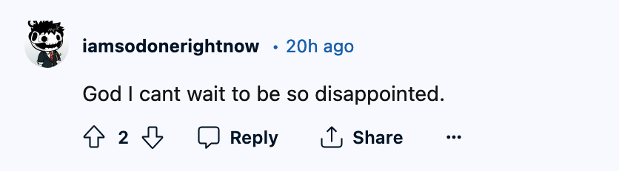
Reddit’s r/movies
33M members
Trailers commonly posted
Valuable insights into audience anticipation
Extract text using Reddit API

Slide 6
Data & Sources
Data
Source
Available Features
1
Movie Names
TMDb API
Titles Release Date, Genres
2
Reddit Posts
Reddit API
Post Title, Post Date, Post Text, Upvotes, Number of Comments
3
Reddit Comments
Reddit API
Comment Text, Comment Date, Upvotes
4
Box Office Metrics
Boxoffice Mojo
Domestic opening
5
Engineered Features
N/A
Comment-level sentiment scoring and topic modeling

Slide 7
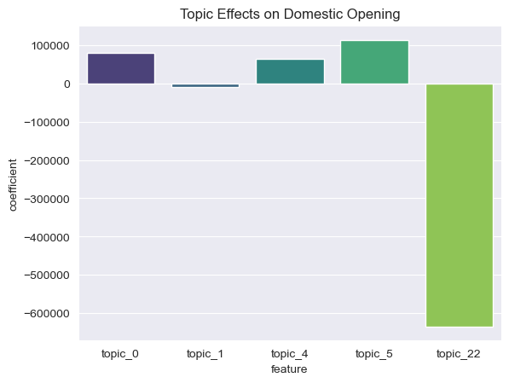
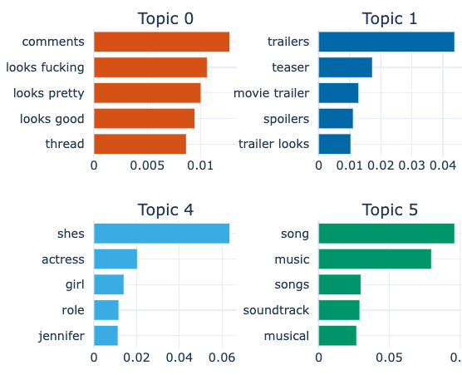
Topic Modeling using BERTopic
Unsupervised clustering powered by embeddings
Silhouette Score: 0.56

Slide 8
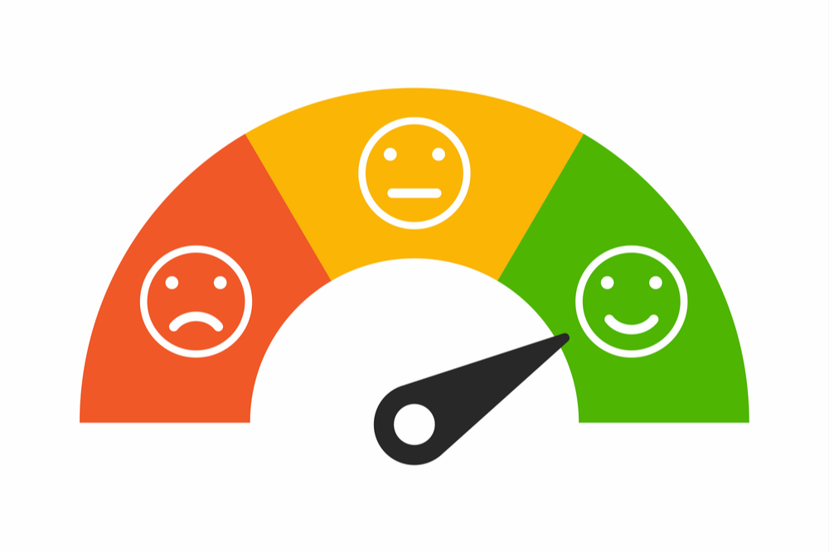
Sentiment Analysis
Pre-trained transformer model from Hugging Face
Detected negative, neutral, and positive comments
Further feature engineering
Weighting, ratios
Aggregations by movie

Slide 9
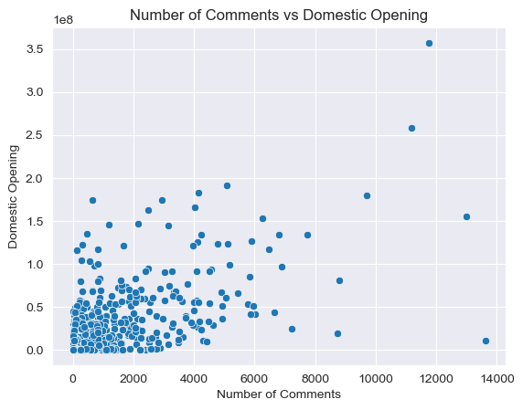
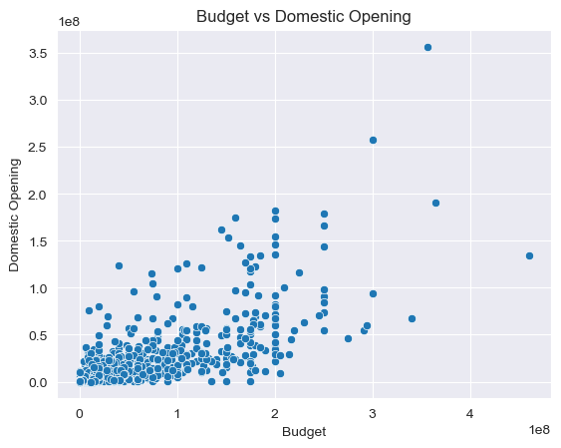
Regression Overview
Started with baseline model
Initial information on predictive power of features
Budget # 1
After diagnostics, explored feature transformations and outlier removal

Slide 10
Regression - Performance Metrics
Model | Train R² | Test R² | Train RMSE | Test RMSE | Train MAE¹ | Test MAE
Baseline MLR | 0.63 | 0.645 | $18,460,701 | $17,055,582 | $4,689,752 | $4,782,502
MLR with Feature Transformation | 0.73 | 0.67 | $25,528,757 | $23,565,896 | $1,409,706 | $1,453,946
Final MLR (w/o influential points²) | 0.76 | 0.72 | $26,721,629 | $21,750,813 | $2,167,161 | $1,576,770
MAE - Median Absolute error - not influenced but outliers.
Based on cook’s distance the influential points were detected and removed before fitting the model

Slide 11
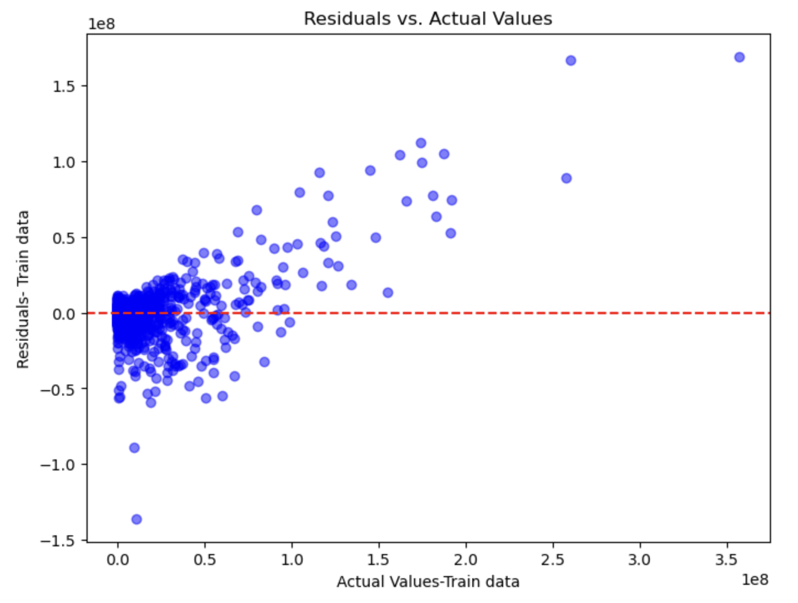
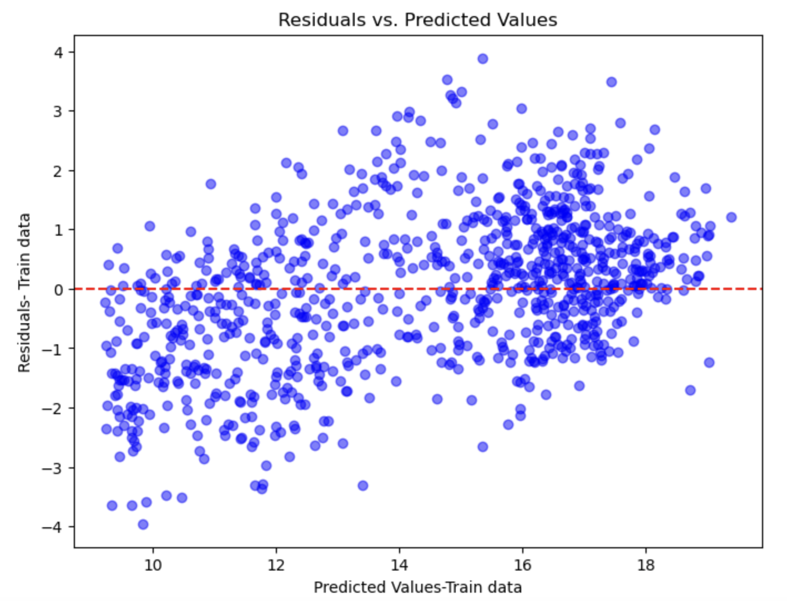
Regression - Model Diagnostics 1/2
Baseline MLR
Final MLR - log(y+1)
Evidence of heteroscedasticity, improved by transformation

Slide 12
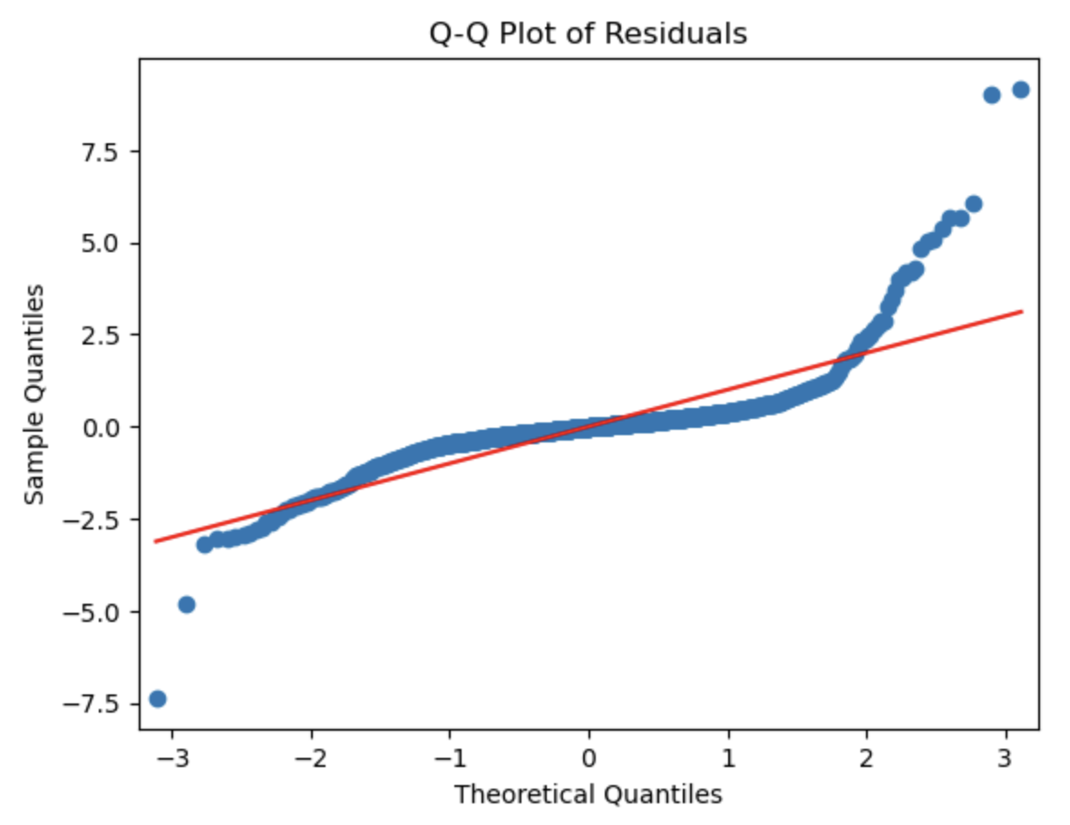
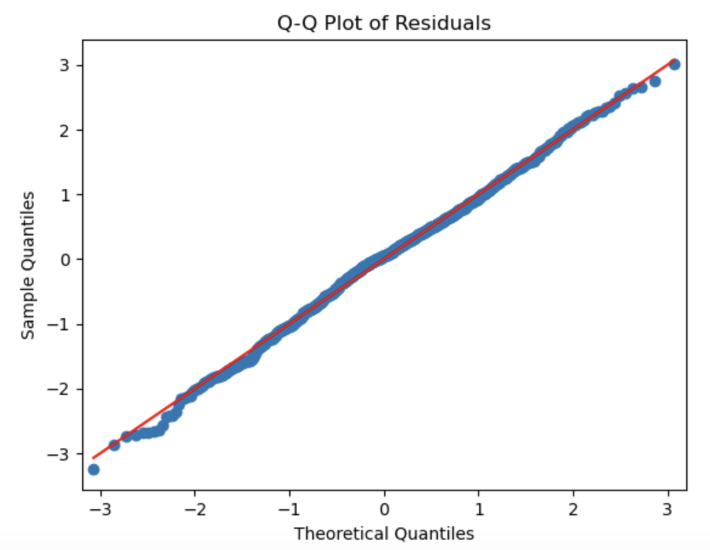
Regression - Model Diagnostics 1/2
Baseline MLR
Final MLR - log(y+1)
Transformations improved normality assumption

Slide 13
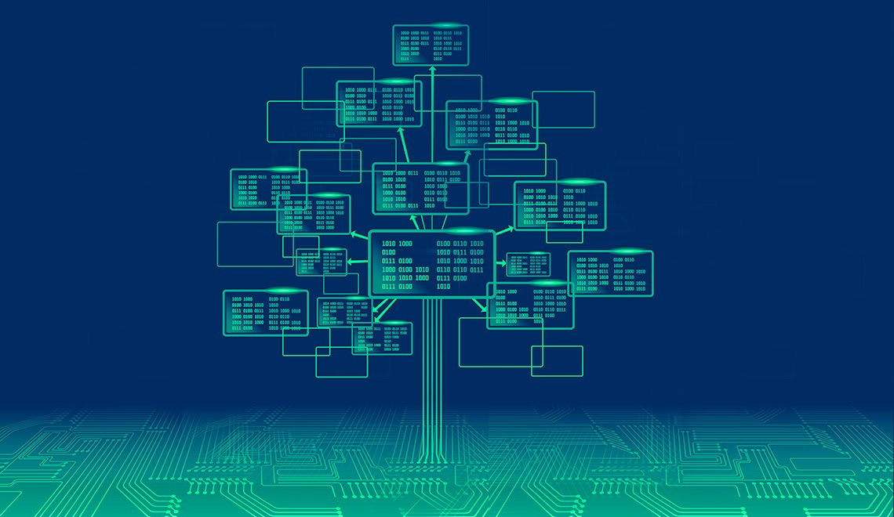
Random Forest Overview
Used grid search 5-fold cross-validation to optimize parameters
Fit and compared random forest and XGBoost model with/without multiple permutations of:
Outlier removal, Feature adjustments, Missing data removal
XGBoost extremely overfit
Random Forest provided best results with full data

Slide 14
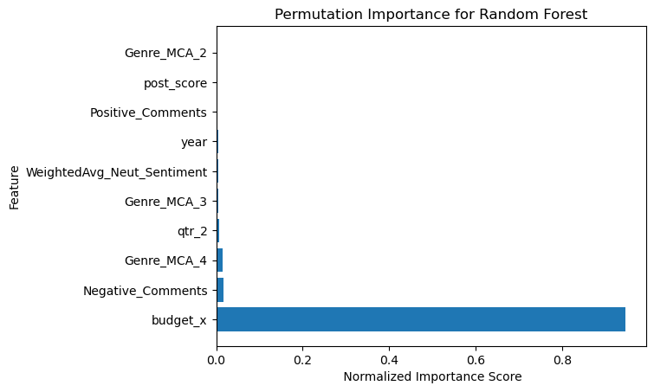

Slide 15
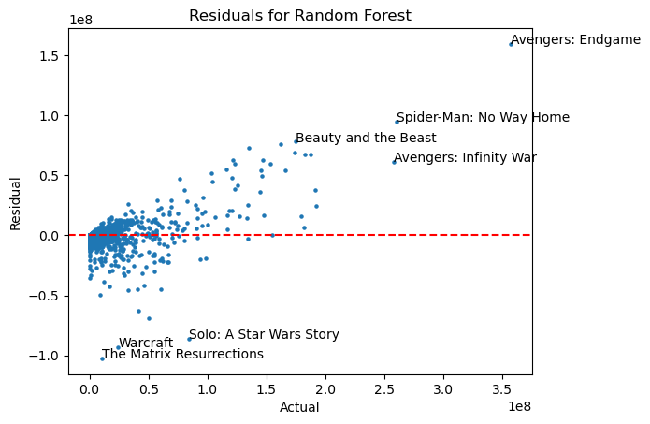

Slide 16
Final Model Performance Overview
Regression
Random Forest
All features + nonlinear transformations.
Target transformation: log(y+1)
Removed outliers
All features and rows
500 trees
Max depth = 10
Min split = 2
Min leaf = 4
R² - 0.72
RMSE - $21,750,813
R² - 0.6959
RMSE - $15,048,721

Slide 17
Conclusions
Best model in explanatory power is a multiple linear regression using -log(1+y) as the response variable with outliers removed
Best model in terms of accuracy is random forest on full dataset
Budget by far most important predictive feature
Comment sentiment appears to have some small amount of predictive power

Slide 18
Limitations & Next Steps
Reddit commenters a small subset of all moviegoers
Potentially increase predictive power by integrating sentiment from multiple sources
Movies from popular IP harder to predict
Potentially different models for popular IP vs other movies
Multitude of other factors go into movie theater attendance
Economic trends, simultaneous streaming release, etc.

